Slide 1

Welcome to the Presentation

Slide 2

Project on “Joint Child Malnutrition Estimates Datasets”

Slide 3

Submitted To: Dr. Mohammad Manzurul Islam
Assistant Professor
Department of Computer Science & Engineering
Submitted By: Group 12
Name | ID
Ratul Saha | 2020-1-60-036
Md. Al Mamun | 2020-1-60-048
Mahmuda Islam Rodela | 2020-2-60-038

Slide 4
Dataset Description
We took a dataset named “Joint Malnutrition Estimates(JME)” from Kaggle to predict the underweight measurements based on other descriptions in the dataset column. We have a total of 35 columns and more than thousand rows. Then we processed the dataset to apply machine learning models to it. We tested the model using four different models and showed the outputs.

Slide 5
Abstract
The project is to develop a model to analyze a dataset based on some model of machine learning. To get good results from the dataset, we need to modify data by considering data preprocessing, feature selection, choosing classification algorithms, and analyzing their performance.

Slide 6
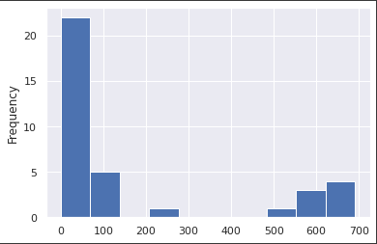
Data Pre-Processing (Fillna & Dropna)
Though there were null values in different columns. So, firstly we plot them in a histogram to get a visualization.
We can see that we got a huge number of null values on our dataset through the plot.

Slide 7
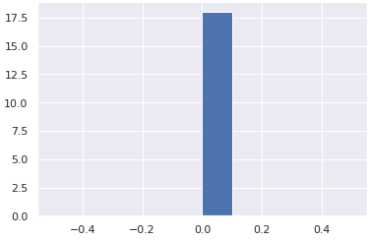
Data Pre-Processing (Histogram)
After found the null values from the columns, we replaced them with mean and median and “ ”.
We plot it by the histogram and the result comes out zero on the null value which is clearly seen in the graph.

Slide 8
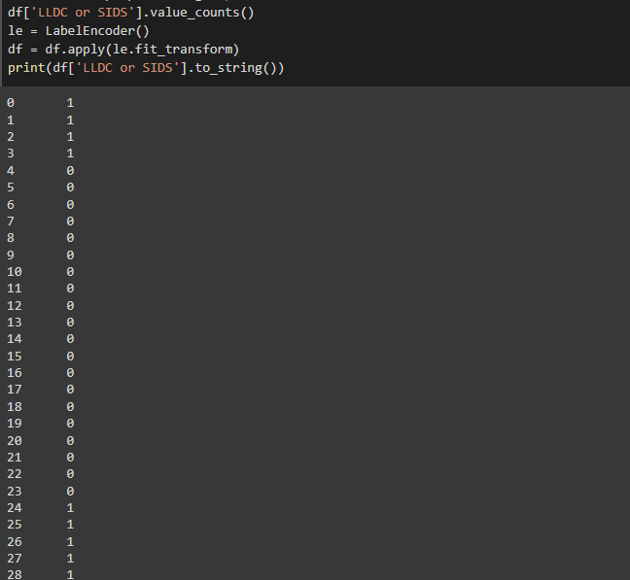
Data Pre-Processing (Transform_value)
We transformed categorical value to numeric values by replacing them with LabelEncoder() and fit_transform() function.

Slide 9
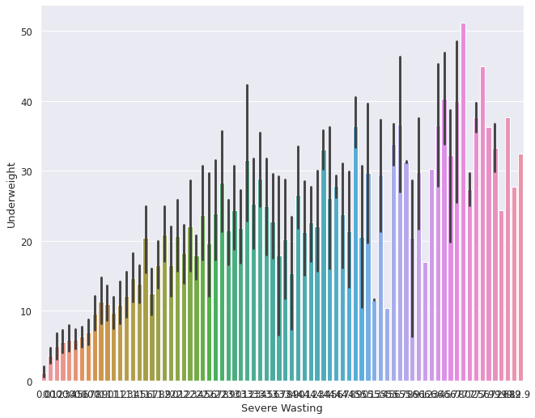
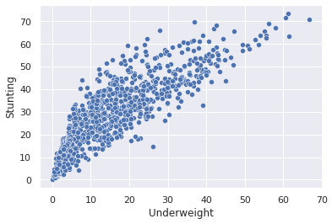
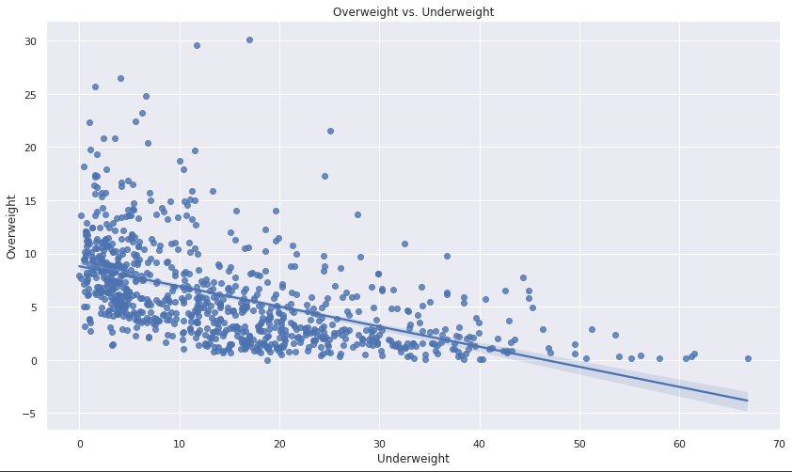
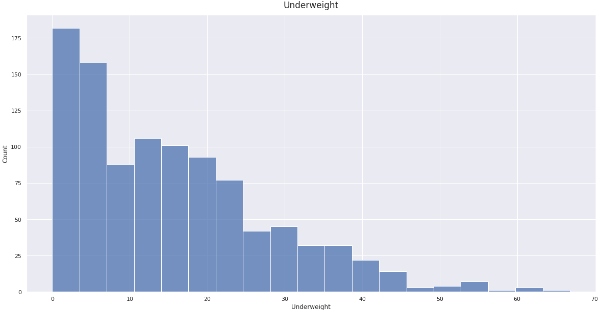
Visualization of Linear Relationships of Columns (Continuous Numerical Variables)
Here we have plotted continuous numerical variables to visualize the data by comparing multiple column.
We have plotted a single column on a histogram.

Slide 10
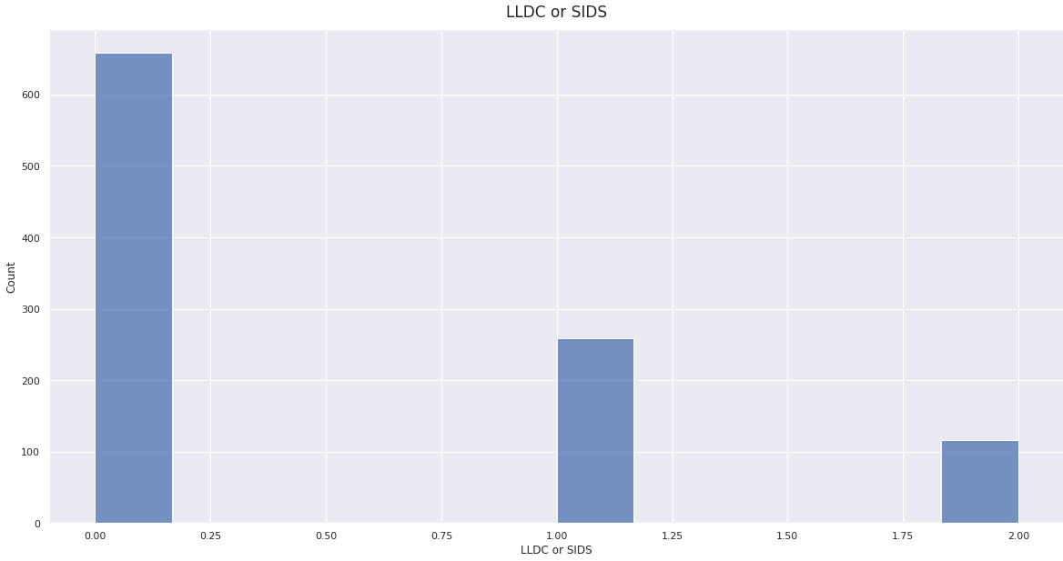
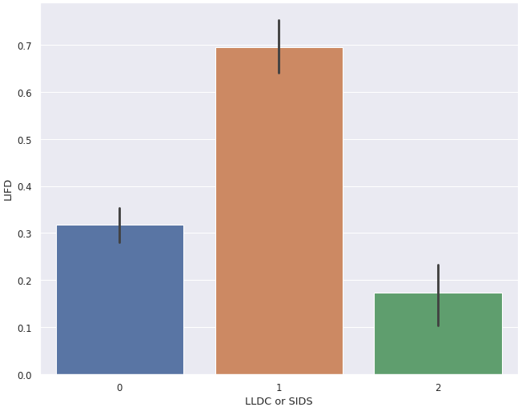
Visualization of Column Relationships (Categorical Variables)
Here we have transformed and encode categorical values from the columns into numerical value.
We have plotted these values into different graphs.

Slide 11
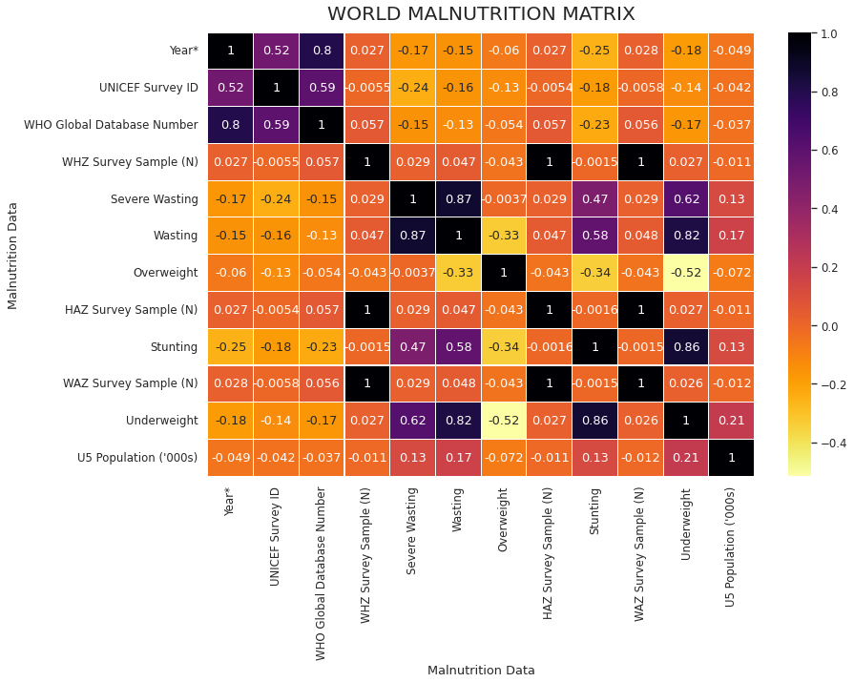
Correlation Matrix
We can see that there is a good relationship between underweight and other columns, we can say, our data pre-processing or cleaning is almost done. It is now ready to split in test and train cases.

Slide 12
Applying Machine Learning Algorithm
We trained 67% data to train our model and kept the remaining 33% data to test the model’s performance.
Among all those, some works for categorical and some works better on numeric variables. So, we applied 4 different algorithms on the dataset and those are
Linear Regression
Logistic Regression
Decision tree
Random forest algorithm

Slide 13
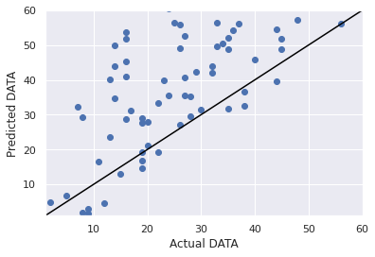
Linear Regression Algorithm
Linear Regression is a machine learning algorithm based on supervised learning. It is mostly used for finding out the relationship between variables and forecasting. As our dataset category matches with its classification, we applied this in our dataset and got R2_score 0.65.

Slide 14
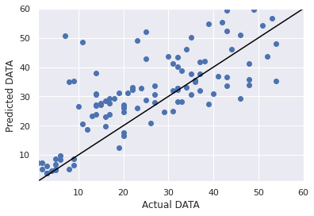
Logistic Regression Algorithm
Logistic regression is used for predicting the categorical dependent variable using a given set of independent variables. It predicts the output of a categorical dependent variable. As our dataset category matches with its classification, we applied this in our dataset and got R2_score -1.07.

Slide 15
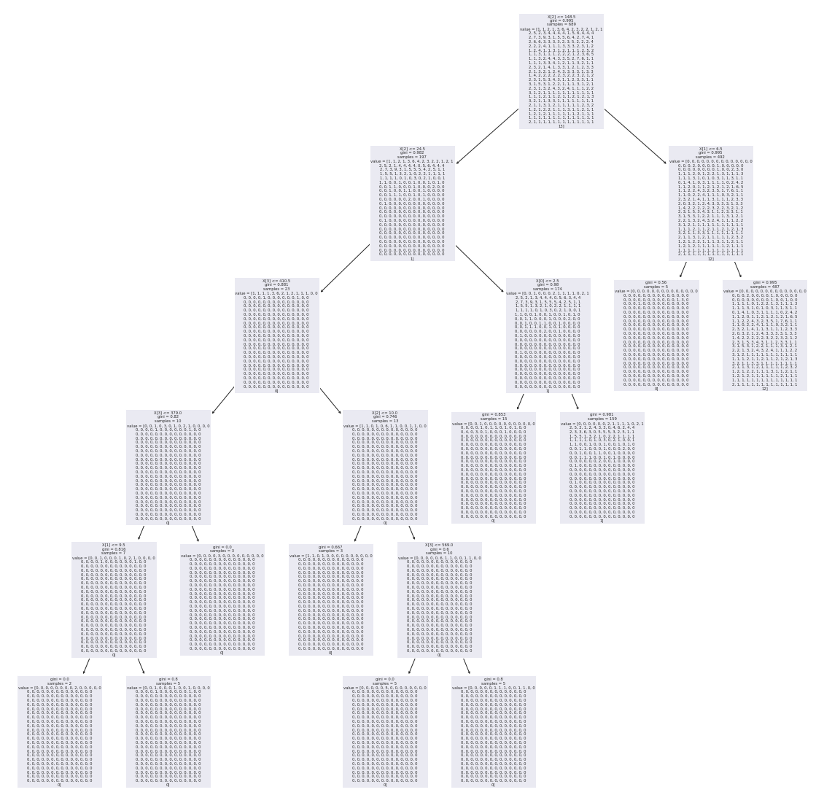
Decision Tree Algorithm
It works well in classifying both categorical and continuous dependent variables. As our dataset category matches with its classification, we applied this in our dataset and got R2_score 0.82.

Slide 16
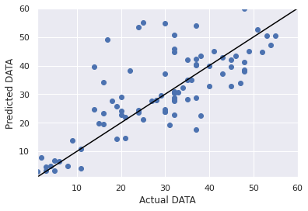
Random Forest Algorithm
We used a decision tree algorithm on our model and sometimes that model shows results in a biased way. To know the accuracy in a more precise way, we implemented a random forest algorithm. It gives the best result with R2_score 0.85.

Slide 17
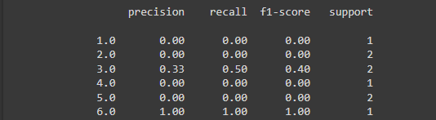
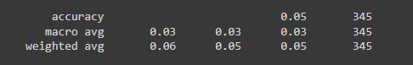
Classification Report(Random forest)

Slide 18
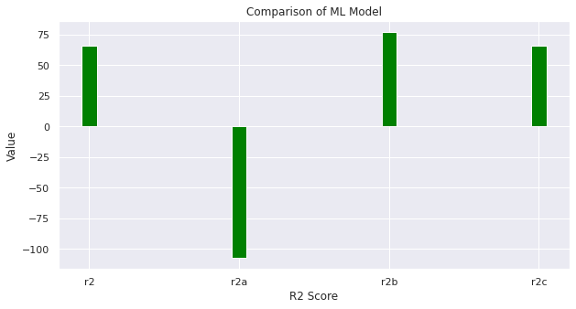
Performance Analysis Graph

Slide 19
Conclusion
That was a great experience for us while working on a dataset using Machine learning model. The journey was started from selecting a suitable dataset and ends with a formal visualization using different models on it. We got quite satisfactory results on the dataset applying different algorithms. We have tried several ways to ensure the best results. Most importantly, we have learned several things along the way.

Slide 20

Thank You

